Slide 1


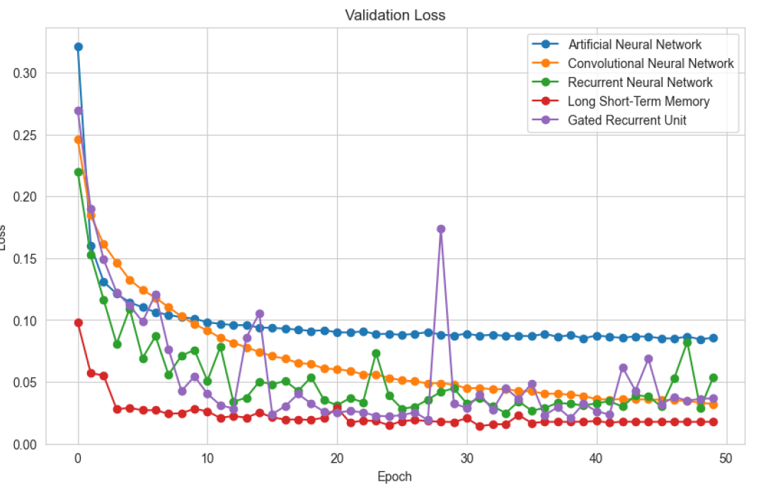
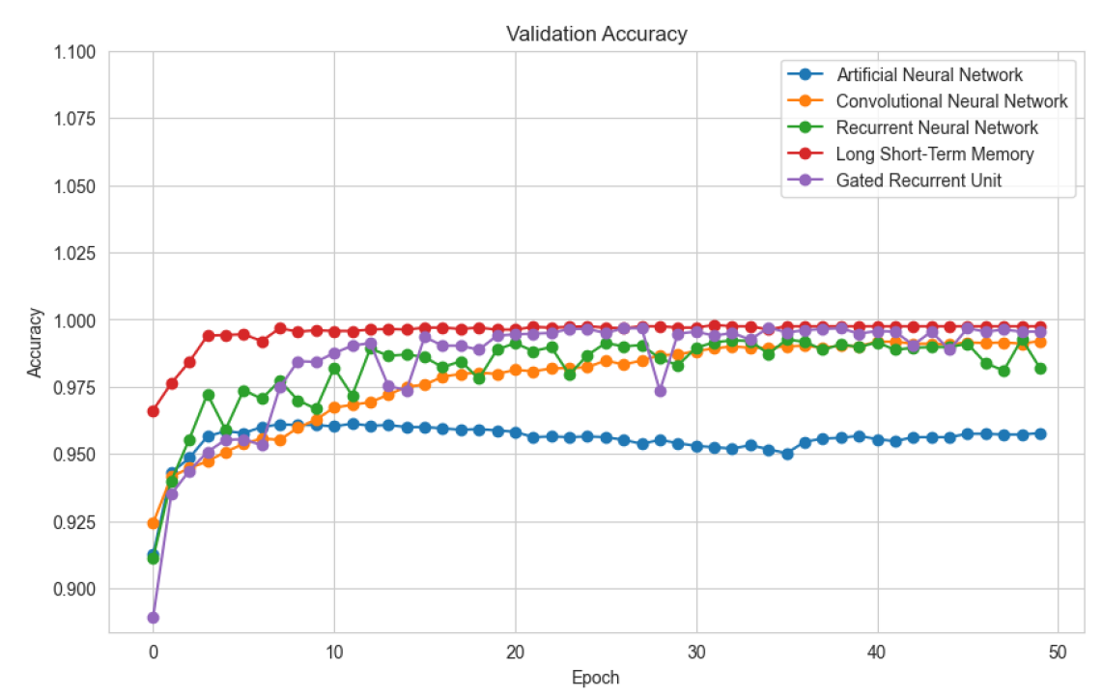
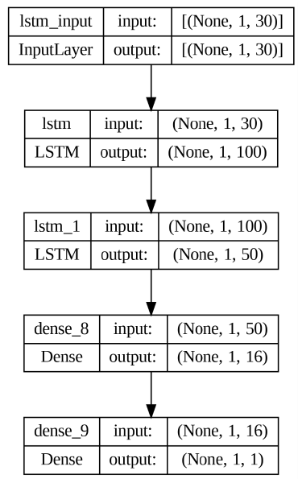
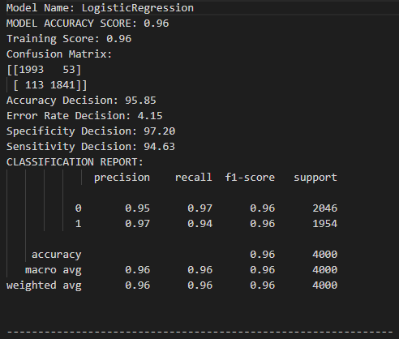
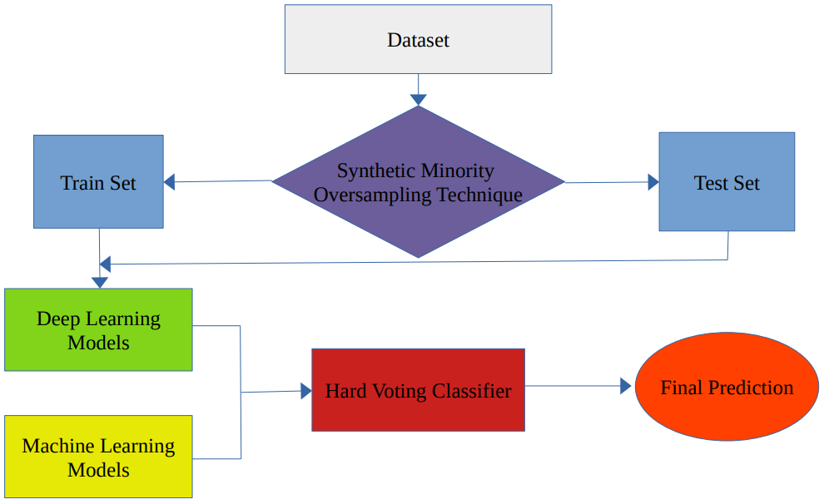
2022-2023 M.Sc. in Data Science and Analytics
EXPLORING DEEP LEARNING AND MACHIINE LEARNING TECHNIQUES TO PREVENT
PAYMENT FRAUDS WITH THE HELP OF ENSEMBLE LEARNING
Yurii Zmytrakov Supervisor: Dr. Fahid Shirazi
Objective:
Develop Machine Learning and Deep Learning models using Ensemble Voting to prevent fraudulent online transactions through binary classification. Determine the most versatile and effective approach for integration into online and e-commerce payment platforms, aiming to reduce financial losses caused by fraud. Identify accuracy-influencing factors, optimize algorithms to minimize false positives and negatives, construct and select features based on domain knowledge and best practices in Machine and Deep Learning for robust fraud detection and enhanced e-commerce and online banking security.
Background:
In an increasingly digital world, safeguarding sensitive information and thwarting fraud is paramount. As online giants like Amazon, Apple, eBay, Microsoft, Best Buy, Walmart and other online retailers dominate the retail landscape, the popularity of online transactions soars. An increasing number of shoppers are transitioning from offline or in-store shopping to online shopping, opting to make payments via credit cards. In 2023, fraudulent transactions are projected to surpass $41 billion globally, a number poised to escalate. Detecting and preventing fraud is vital for both customer protection and retailer revenue preservation. This study introduces an ensemble approach, combining voting and deep learning models, for fraudulent online transaction detection. Approach efficacy will be gauged using accuracy, precision, recall, and confusion matrix metrics.
Results:
Model | Accuracy
Logistic Regression | 0.98
Support Vector Classification | 0.98
Decision Tree | 0.95
Random Forest | 1
KNN | 0.998
Artificial Neural Nework | 0.96
Convolutional Neural Network | 0.985
Recurrent Neural Network | 0.982
Long Short-Term Memory | 0.992
Gated Recurrent Unit | 0.99
Ensemble voting | 0.97
Loss plot
Accuracy plot
Methodology:
Utilize a comprehensive approach combining both machine learning and deep learning methodologies to tackle the challenge of credit card fraud detection. This entails implementing five distinct machine learning models—Logistic Regression, Support Vector Machine, Decision Tree (depth=5), Random Forest (max sample 0.75), and K-Nearest Neighbors (neighbours=6)—and an additional five deep learning models—namely, Artificial Neural Network, Convolutional Neural Network, Recurrent Neural Network, Long Short-Term Memory, and Gated Recurrent Unit. Assessing these models' effectiveness involves the application of the confusion matrix to evaluate true positives, true negatives, false positives, and false negatives—providing invaluable insights into their performance. Moreover, key performance metrics such as accuracy, precision, recall, F1 Score, and Area Under the ROC Curve (AUC-ROC) will be leveraged to holistically gauge each model's capability in accurately detecting credit card fraud.
Conclusions:
SMOTE was effective in addressing highly imbalanced dataset (99.8% non-fraudulent, 0.2% fraudulent transactions) by generating synthetic instances of minority class by interpolating between existing instances.
Initial machine learning models, including LR, SVM, DT,RF, and KNN displayed varying performances. Remarkably, excelled in fraud detection.
CNN displayed prowess in spotting false negatives, while LSTM and GRU showed comparable patterns.
LSTM slightly outperformed GRU due to the specific temporal dependencies and patterns present in fraudulent activities, because of LSTM ability to capture the intricacies of fraud detection
Epoch variations had mixed effects on performance across all models.
Balancing accuracy and time complexity proved crucial in determining the winning model. LSTM and GRU took significantly longer to train compared to Random Forest. Depending on the business requirements, it can prove advantageous to mark suspicious transactions for manual approval. The occurrence of false negatives should not pose an issue.
Ensemble voting resulted in a reduction in our model's accuracy. In future work, rather than optimizing models individually, we can explore the optimization of models as a unified classification model.
Future work could focus on improving data quality and preprocessing for informative features.
LSTM and GRU architecture
Confusion Matrix example
Ensemble Voting Classifier

